Slide 1


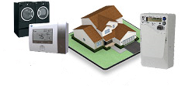
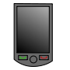
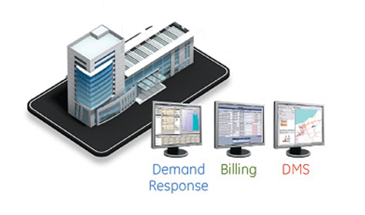
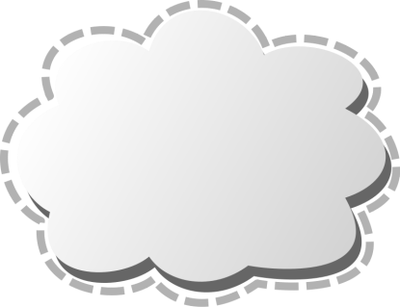


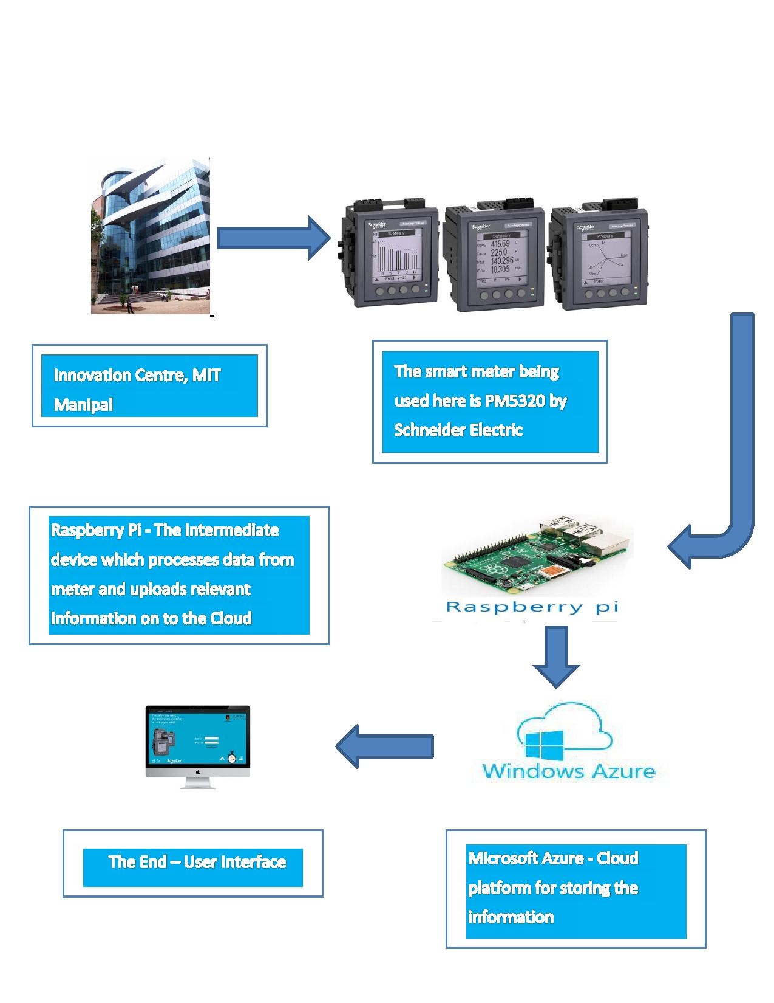
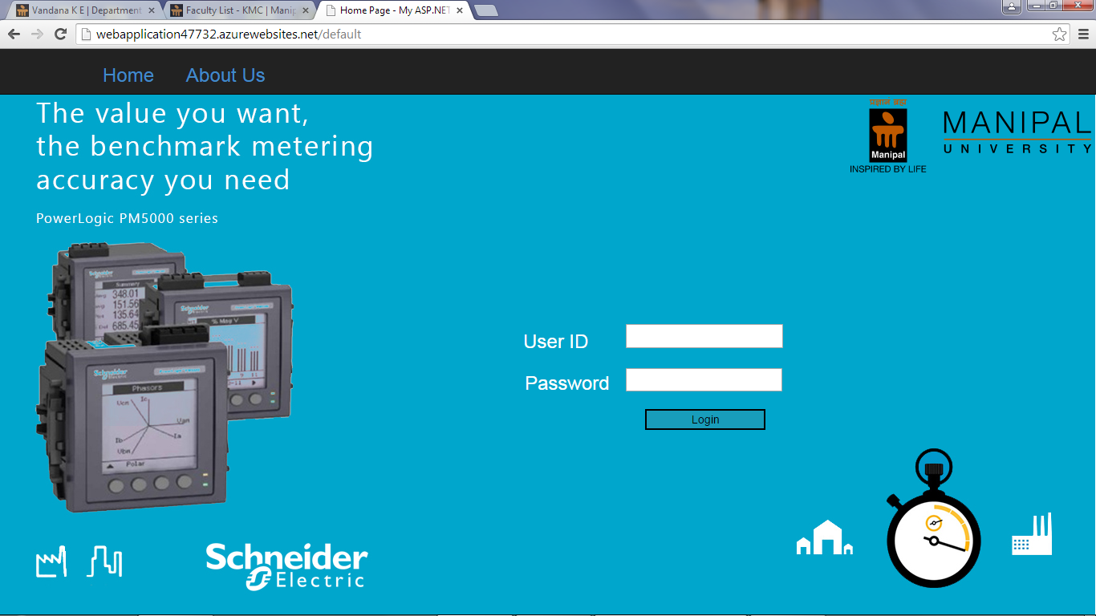
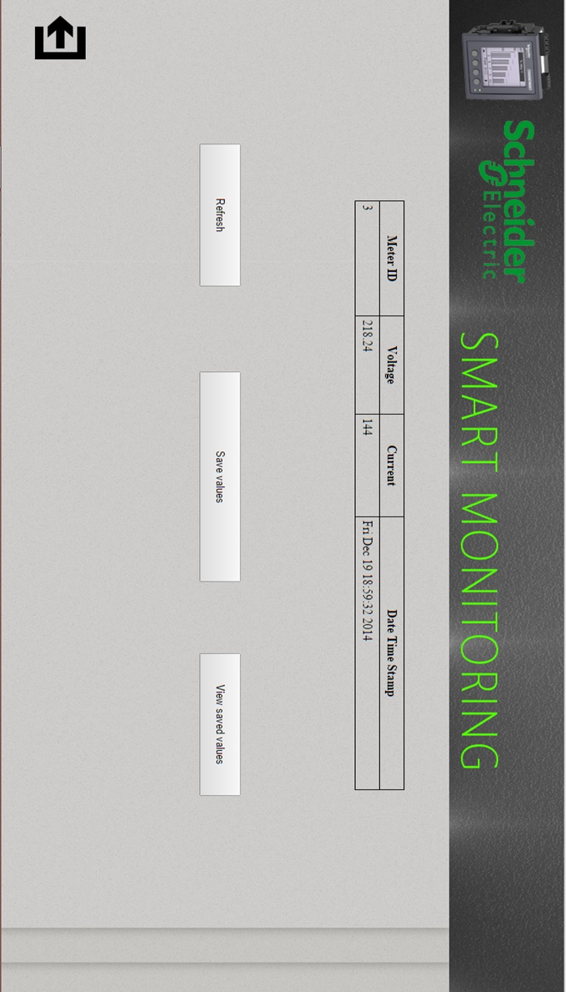
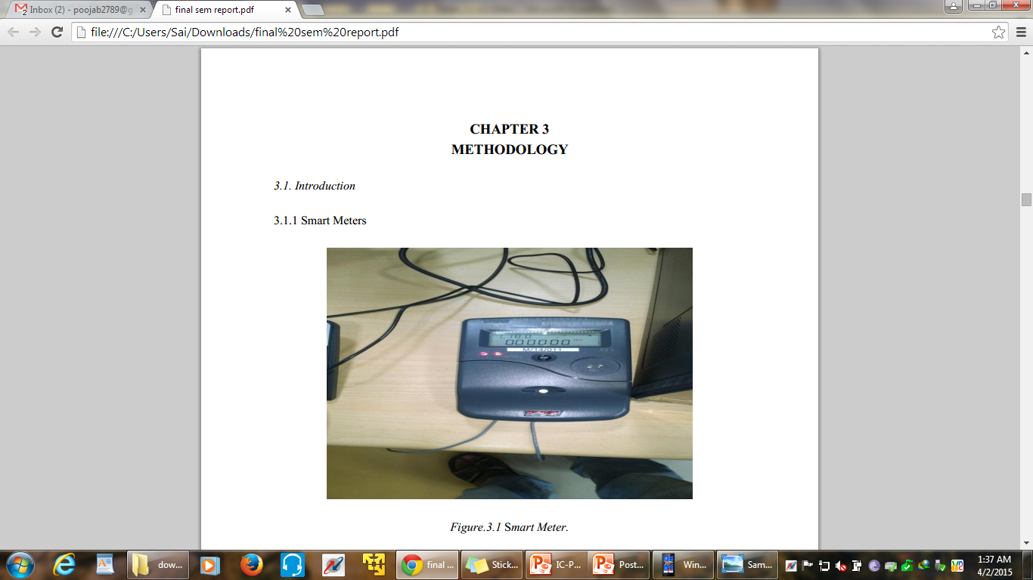
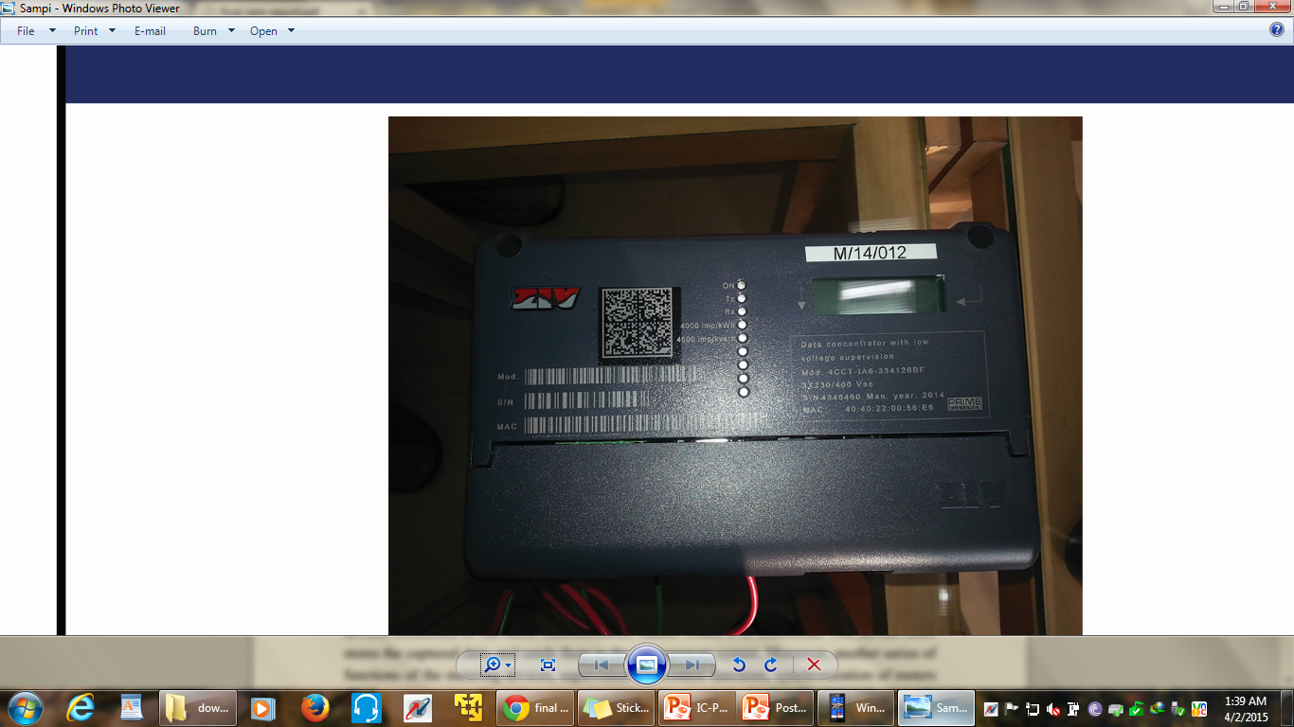
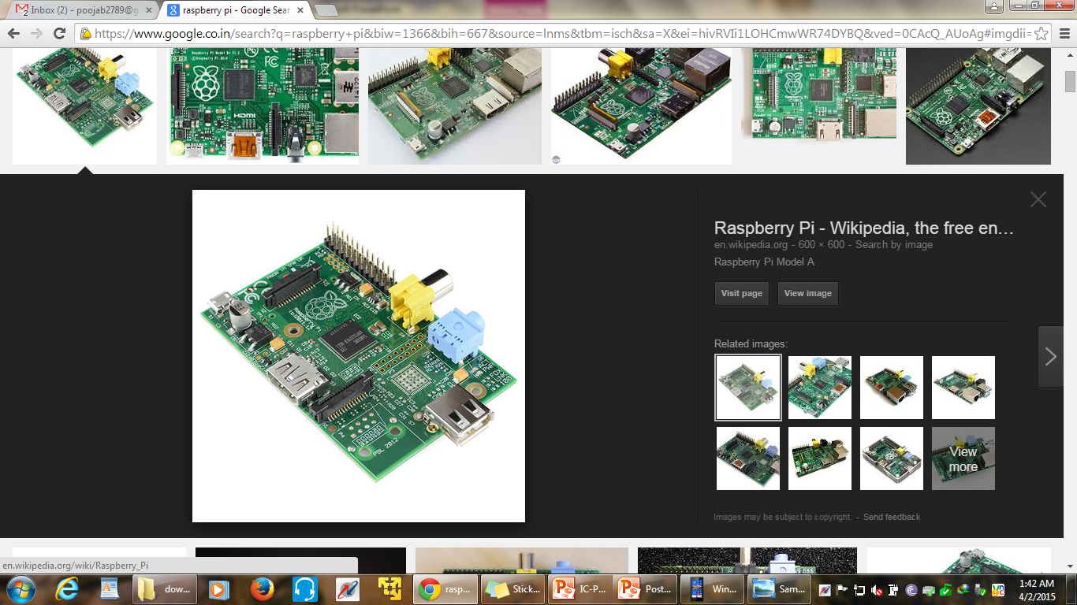
I
Smart Metering
Dr. Manohara Pai M.M.¹, Dr. Radhika M. Pai², Ms. Pooja B³, Anindya A.S.⁴, M.S. Srinivas⁴, Shubankar M⁴, Saina R. Z.⁴
¹ Dr. TMA Pai Endowment chair in Cloud Computing and Data Analytics & Professor, ²Professor, ³ Assistant Professor, ⁴Student
Innovation Centre, Manipal Institute of Technology (MIT), Manipal University, Manipal, Karnataka, India
INTRODUCTION
A smart meter is an electronic device that records consumption of electric energy in intervals of an hour or less and communicates that information daily back to the utility for monitoring and billing purposes.
Smart meters enable two-way communication between the meter and the central system. Unlike home energy monitors, smart meters can gather data for remote reporting.
These meters offer potential benefits to the customers in terms of estimated bills and a better way to manage the energy resources.
Smart Meter
Smart Appliance
Utility Monitoring Station
Internet
BLOCK DIAGRAM
IPv4 Enabled Smart Metering Systems
IPv6 Enabled Smart Metering Systems
IPv6 Enabled Smart Meters
Data Concentrator Unit (DCU)
Embedded Boards
Internet
APPLICATIONS
Produce Error Free Bills
Better Utilization of Energy Resources
Detection of Current Leakage
Identification of Power Consumption by Smart Appliance.

